Slide 1
Distributed System Principles
Naming: 5.1
Consistency & Replication: 7.1-7.2
Fault Tolerance: 8.1

Slide 2
Naming
Names are associated to entities (files, computers, Web pages, etc.)
  Entities (1) have a location and (2) can be operated on.
Name Resolution: the process of associating a name with the entity/object it represents.
  Naming systems prescribe the rules for doing this.

Slide 3
Names
Types of names
  Addresses
  Identifiers
  Human friendly
Representation of names
  Human friendly format
  Machine readable – generally random bit strings

Slide 4
Addresses as Names
To operate on an entity in a distributed system, we need an access point.
Access points are physical entities named by an address.
  Compare to telephones, mailboxes
Objects may have multiple access points
  Replicated servers represent a logical entity (the service) but have many access points (the various machines hosting the service)

Slide 5
Addresses as Names
Entities may change access points over time
  A server moves to a different host machine, with a different address, but is still the same service.
New entities may take over the vacated access point and its address.
Better: a location-independent name for an entity E
  should be independent of the addresses of the access points offered by E.

Slide 6
Identifiers as Names
Identifiers are names that are unique and location independent.
Properties of identifiers:
  An identifier refers to at most one entity
  Each entity has at most one identifier
  An identifier always refers to the same entity; it is never reused.
Human comparison?
An entity’s address may change, but its identifier cannot change.

Slide 7
Human-Friendly Names
Human-friendly names are designed to be used by humans instead of a computer
They usually contain contextual information; e.g., file names or DNS names.
Do not usually contain information that is useful to a computer

Slide 8
Representation
Addresses and identifiers are usually represented as bit strings (a pure name) rather than in human readable form.
  Unstructured or flat names.
Human-friendly names are more likely to be character strings (have semantics)

Slide 9
Name Resolution
The central naming issue: how can other forms of names (human-friendly, identifiers) be resolved to addresses?
Naming systems maintain name-to-address bindings
In a distributed system a centralized directory of name-address pairs is not practical.

Slide 10
Naming Systems
Flat Naming
  Unstructured; e.g., a random bit string
Structured Naming
  Human-readable, consist of parts; e.g., file names or Internet host naming
Attribute-Based Naming
  An exception to the rule that named objects must be unique
  Entities have attributes; request an object by specifying the attribute values of interest.

Slide 11
3.2 Flat Naming
Addresses and identifiers are usually pure names (bit strings – often random)
Identifiers are location independent:
  Do not contain any information about how to locate the associated entity.
Addresses are not location independent.
In a small LAN name resolution can be simple.
  Broadcast or multicast to all stations in the network.
  Each receiver must “listen” to network transmissions
  Not scalable

Slide 12
Flat Names – Resolution in WANs
Simple solutions for mobile entities
  Chained forwarding pointers
    Directory locates initial position; follow chain of pointers left behind at each host as the server moves
    Broken links
  Home-based approaches
    Each entity has a home base; as it moves, update its location with its home base.
    Permanent moves?
Distributed hash tables (DHT)

Slide 13
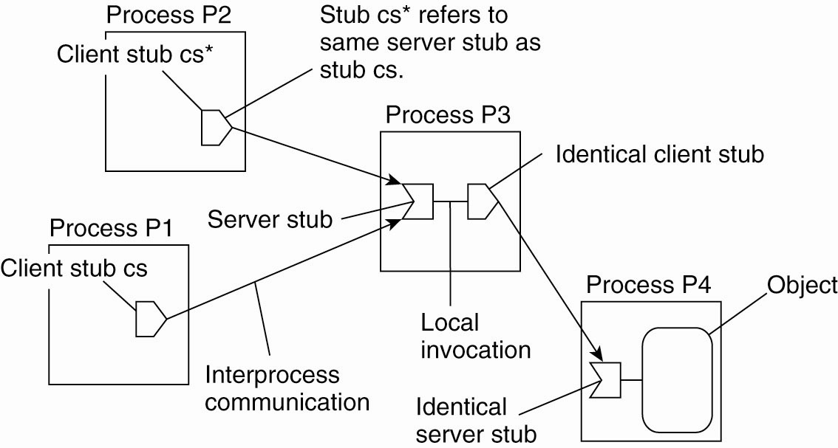
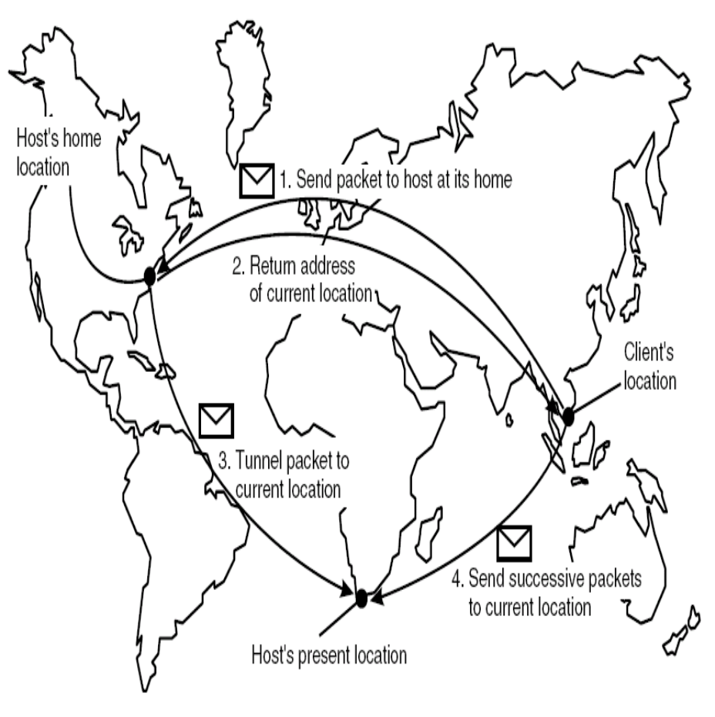
Useful for contacting mobile hosts

Slide 14
Distributed Hash Tables/Chord
Chord is representative of other DHT approaches
It is based on an m-bit identifier space: both host node and entities are assigned identifiers from the name space.
  Entity identifiers are also called keys.
  Entities can be anything at all

Slide 15
Chord
An m-bit identifier space = 2^{m} identifiers.
  m is usually 128 or 160 bits, depending on hash function used.
Each node has an m-bit id, obtained by hashing some node identifier (IP address?)
Each entity has a key value, determined by the application (not Chord) which is hashed to get its m-bit identifier k
Nodes are ordered in a virtual circle based on their identifiers.
An entity with key k is assigned to the node with the smallest identifier id such that id ≥ k. (the successor of k)

Slide 16
Simple but Inefficient Name Resolution
Each node p knows its immediate neighbors, its immediate successor, succ(p + 1) and its predecessor, denoted pred(p).
When given a request for key k, a node checks to see if it has the object whose id is k. If so, return the entity; if not, forward request to one of its two neighbors.
Requests hop through the network one node at a time.

Slide 17
Finger Tables – A Better Way
Each node maintains a finger table containing at most m entries.
For a given node p, the ith entry is
FT_{p}[i]= succ(p + 2^{i-1}), the 1st node succeeding p by at least 2^{i-1}.
Finger table entries are short-cuts to other nodes in the network.
  As the index in the finger table increases, the distance between nodes increases exponentially.

Slide 18
Finger Tables (2)
To locate an entity with key value = k, beginning at node p
  If p stores the entity, return to requestor
  Else, forward the request to a node q in p’s finger table
  Node q has index j in p’s finger table; j satisfies the relation
  q = FT_{p}[j] ≤ k < FT_{p}[j + 1]

Slide 19
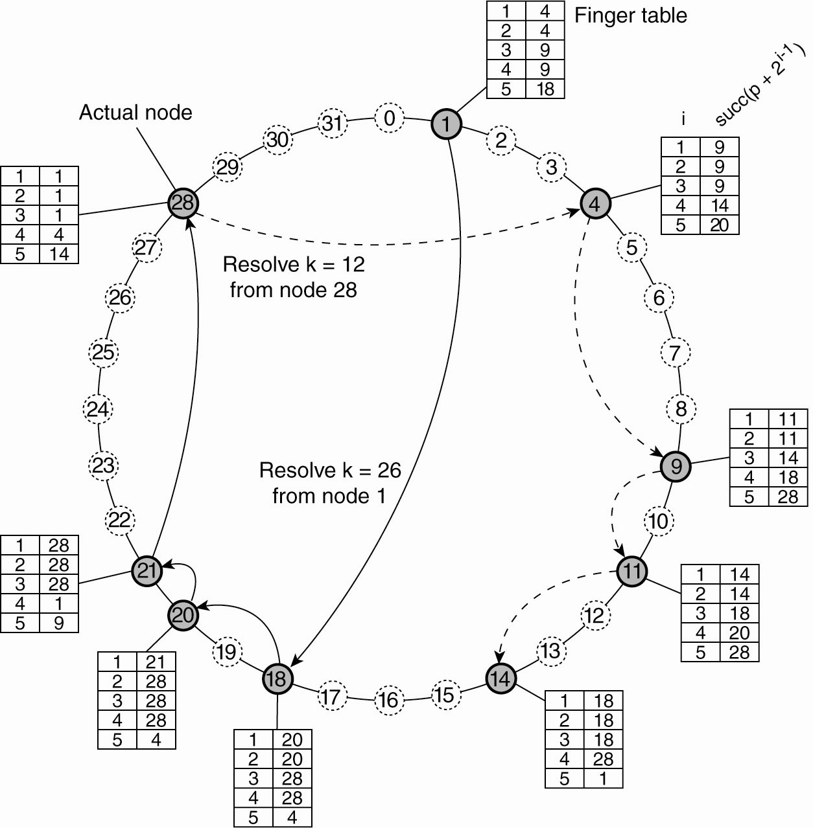
Distributed Hash Tables
General Mechanism
Figure 5-4. Resolving key 26 from node 1 and key 12 from node 28
Finger Table entry:
  FTp[i] = succ(p+2^{i-1})

Slide 20
Performance
Lookups are performed in O(log(N)) steps, where N is the number of nodes in the system.
Joining the network : Node p joins by contacting a node and asking for a lookup of succ(p+1).
  p then contacts its successor node and tables are adjusted.
Background processes constantly check for failed nodes and rebuild the finger tables to ensure up-to-date information.

Slide 21
5.3 Structured Naming
Flat name – bit string
Structured name – sequence of words
Name spaces for structured names – labeled, directed graphs
Example: UNIX file system
Example: DNS (Domain Name System)
  Distributed name resolution
  Multiple name servers

Slide 22
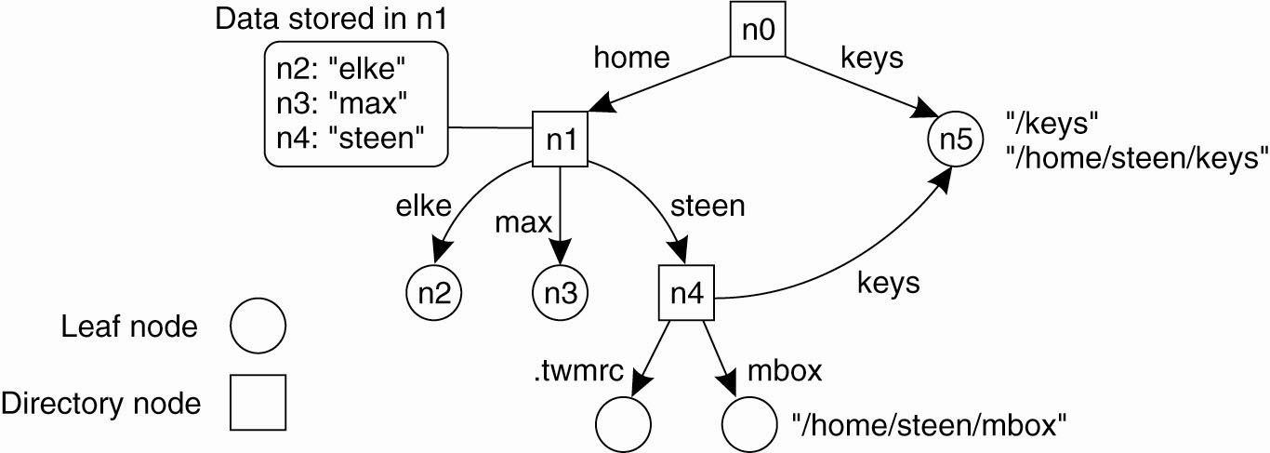
Name Spaces - Figure 5-9
Entities in a structured name space are named by a path name
Leaf nodes represent named entities (e.g., files) and have only incoming edges
Directory nodes have named outgoing edges and define the path used to find a leaf node

Slide 23
5.4 – Attribute-Based Naming
Allows a user to search for an entity whose name is not known.
Entities are associated with various attributes, which can have specific values.
By specifying a collection of <attribute, value> pairs, a user can identify one (or more) entities
Attribute based naming systems are also referred to as directory services, as opposed to naming systems.

Slide 24
5.4 – Attribute-Based Naming
Examples: search a music data base for a particular kind of music, or music by a particular artist, or . . .
Difficulty: choosing an appropriate set of attributes – how many, what variety, etc.
  E.g., should there be a category for ragga music (a type of reggae)?
Satisfying a request may require an exhaustive search through the complete set of entity descriptors

Slide 25
Attribute-Based Naming
Not particularly scalable if it requires storing all descriptors in a single database.
RDF: Resource Description Framework
  Standardized data representation for the Semantic Web
  Subject-predicate-object triplet (person, name, Alice)
Some proposed solutions: (page 218)
  LDAP (Lightweight Directory Access Protocol) combines structured naming with attribute based names. Provides access to directory services via the Internet.

Slide 26
Distributed System Principles
Consistency and Replication

Slide 27
7.1:Consistency and Replication
Two reasons for data replication:
  Reliability (backups, redundancy)
  Performance (access time)
Single copies can crash, data can become corrupted.
System growth can cause performance to degrade
  More processes for a single-server system slow it down.
  Geographic distribution of system users slows response times because of network latencies.

Slide 28
Reliability
Multiple copies of a file or other system component protects against failure of any single component
Redundancy can also protect against corrupted data; for example, require a majority of the copies to agree before accepting a datum as correct.

Slide 29
Performance
Replicated servers can process more requests in the same amount of time.
Geographically distributed servers can reduce latencies.
Performance is directly related to scalability (scalability = the ability to maintain acceptable performance as the system expands in one or more of the three dimensions of scalability).

Slide 30
Replication and Scaling
Replication and caching can increase system scalability
  Multiple servers, possibly even at multiple geographic sites, improves response time
  Local caching reduces the amount of time required to access centrally located data and services
But…updates may require more network bandwidth, and consistency now becomes a problem; consistency maintenance causes scalability problems.

Slide 31
Consistency
Copies are consistent if they are the same.
  Reads should return the same value, no matter which copy they are applied to
  Sometimes called “tight consistency”, “strict consistency”, or “UNIX consistency”
One way to synchronize replicas: use an atomic update (transaction) on all copies.
  Problem: distributed agreement is hard, requires a lot of communication & time

Slide 32
The Dilemma
Replication and caching promote scalability, thus improving performance over a system where resources are centralized.
Maintaining consistency among all copies generally requires global synchronization, which has a negative effect on performance.
What to do?

Slide 33
Consistency Models
Relax the requirement that all updates be carried out atomically.
  Result – copies may not always be identical
Solution: different definitions of consistency, know as consistency models.
As it turns out, we may be able to live with occasional inconsistencies.

Slide 34
What is a consistency model?
“… a contract between processes and the data store. It says that if processes agree to obey certain rules, the store promises to work correctly.”
Strict consistency: a read operation should return the results of the “last” write operation regardless of where the reads and writes take place.
  In a distributed system, how do you even know which write is the “last” one?
Alternative consistency models weaken the definition.

Slide 35
Consistency Models
No “best” way to manage replicated data – depends on the application.
A more relaxed consistency model (i.e., not “strict” consistency) is thus somewhat application dependent.
Researchers have looked at several models: continuous consistency, sequential consistency, lazy consistency, …
We will return to this topic when we discuss distributed file systems.

Slide 36
Update Ordering
Some models are concerned with updates to shared, replicated data.
Updates may be received in different orders at different sites, especially if replicas are distributed across the whole system, because
  of differences in network transmission
  Because a conscious decision is made to update local copies only periodically

Slide 37
7.2.2: Consistent Ordering of Operations
Replicas need to agree on order of updates
Assures eventual consistency.
No traditional synchronization applied.
Processes may each have a local copy of the data (as in a cache) and rely on receiving updates from other processes, or updates may be applied to a central copy and its replicas.

Slide 38
Causal Consistency
A consistency model that requires agreement on the order of updates.
Writes that may be causally related must be seen by all processes in the same order. “Concurrent” (not causally related) writes may be seen in a different order on different machines.
To implement causal consistency, there must be some way to track which processes have seen which writes. Vector timestamps (Ch. 6) are one way to do this.

Slide 39
Distributed System Principles
Fault Tolerance

Slide 40
Fault Tolerance - Introduction
Fault tolerance: the ability of a system to continue to provide service in the presence of faults. (System: a collection of components: machines, storage devices, networks, etc.)
Fault: the cause of an error; e.g., faulty network
Error: a system condition that can lead to failure; e.g., receive damaged packets (bad data)
Failure: A system fails if it cannot provide its users with the services it promises (its behavior doesn’t match its specification.)
Fault tolerant systems should be able to recover from partial failure (failure of one or few components) without seriously affecting overall performance

Slide 41
Fault Classification
Transient: Occurs once and then goes away; non-repeatable
Intermittent: the fault comes and goes; e.g., loose connections can cause intermittent faults
Permanent (until the faulty component is replaced): e.g., disk crashes

Slide 42
Basic Concepts
Goal: Distributed systems should be constructed so that they can seamlessly recover from partial failures without a serious effect on the system performance.
Dependable systems are fault tolerant
Characteristics of dependable systems:
  Availability
  Reliability
  Safety
  Maintainability
  Technical Committee 56 Dependability of the International Electrotechnical Commission (IEC)

Slide 43
Dependability
Availability: the property that the system is instantly ready for use when there is a request
Reliability: the property that the time between failures is very large; the system can run continuously without failing
Availability: at an instant in time; reliability: over a time interval
  The system that fails once an hour for .01 second is highly available, but not reliable

Slide 44
Dependability
Safety: if the system does fail, there should not be disastrous consequences
Maintainability: the effort required to repair a failed system should be minimal.
  Easily maintained systems are typically highly available
  Automatic failure recovery is desirable, but hard to implement.

Slide 45
Failure Models
In this discussion we assume that the distributed system consists of a collection of servers that interact with each other and with client processes.
Failures affect the ability of the system to provide the service it advertises
In a distributed system, service interruptions may be caused by the faulty performance of a server or a communication channel or both
Dependencies in distributed systems mean that a failure in one part of the system may propagate to other parts of the system

Slide 46
Failure Type | Description
Crash | Server halts, but worked correctly until it failed
Omission Receive omission Send omission | Server fails to respond to requests Server fails to receive in messages Server fails to send message
Timing | Response is outside allowed time interval
Response Value failure State transition | A server’s response is incorrect The value of the response is wrong The server deviates from the correct flow of control
Arbitrary | Arbitrary results produced at arbitrary times: Byzantine failures

Slide 47
Failure Types
Crash failures are dealt with by rebooting, replacing the faulty component, etc.
  Also known as fail-stop failure
  This type of failure can be detectable by other processes, or may even be announced by the server
  How to distinguish crashed server from slow server?
Omission failures may be the result of a failed server.
  Fail-silent system
  Are hard to recognize & can be caused by lost requests, lost responses, processing error at the server, server failure, etc.
  Client may reissue the request
  What to do if the error was due to a send omission? Server thinks it has performed the task – how will it react to a repeated request

Slide 48
Failure Types
Timing failure: (recall isochronous data streams from Chapter 4)
  May cause buffer overflow and lost message
  May cause server to respond too late (performance error)
Response failures may be
  value failures: e.g., database search that returns incorrect or irrelevant answers
  state transition failure; e.g., unexpected response to a request; maybe because it doesn’t recognize the message

Slide 49
Failure Types
Arbitrary failures: Byzantine failures
  Characterized by servers that produce wrong output that can’t be identified as incorrect
  May be due to faulty, but accidental, processing by the server
  May be due to malicious & deliberate attempts to deceive; server may be working in collaboration with other servers
“Byzantine” refers to the Byzantine empire; a period supposedly marked by political intrigue and conspiracies

Slide 50
Failure masking by redundancy
Redundancy is a common way to mask faults.
Three kinds:
  Information redundancy
    e.g., Hamming code or some other encoding system that includes extra data bits that can be used to reconstruct corrupted data
  Time redundancy
    Repeat a failed operation
    Transactions use this approach
    Works well with transient or intermittent faults
  Physical redundancy
    Redundant equipment or processes

Slide 51
Triple Modular Redundancy (TMR) an example of physical redundancy
Used to build fault tolerant electronic circuits
Technique can be applied to computer systems as well
Three devices at each stage; output of all three goes to three “voters”; which forward the majority result to the next device
Figure 8-2, page 327

Slide 52
Process Resilience
Protection against failure of a process
Solution: redundant processes, organized as a group.
When a message is sent to a group all members get it. (TMR principle)
  Normally, as long as some processes continue to run, the system will continue to run correctly

Slide 53
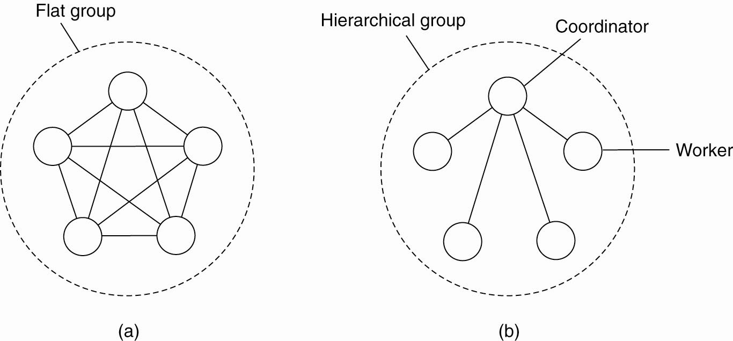
Process-Group Organization
Flat groups
  All processes are peers
  Usually, similar to a fully connected graph
  – communication between each pair of processes
Hierarchical groups
  Tree structure with coordinator
  Usually two levels

Slide 54
Flat versus Hierarchical
Flat
  No single point of failure
  More complex decision making – requires voting
Hierarchical
  More failure prone
  Centralized decision making is quicker.

Slide 55
Failure Masking and Replication
Process group approach replicates processes instead of data (a different kind of redundancy)
Primary-based protocol
  A primary (coordinator) process manages the work of the process group; e.g., handling all write operations but another process can take over if necessary
Replicated or voting protocol
  A majority of the processes must agree before action can be taken.

Slide 56
Simple Voting
Assume a distributed file system with a file replicated on N servers
To write: assemble a write quorum, N_{W}
To read: assemble a read quorum, N_{R}
Where
  N_{W} + N_{R} > N // no concurrent reads & writes
  N_{W} > N/2 // only one write at a time

Slide 57
Process Agreement
Process groups often must come to a consensus
  Transaction processing: whether or not to commit
  Electing a coordinator; e.g., the primary
  Synchronization for mutual exclusion
  Etc.
Agreement is a difficult problem in the presence of faults.

Slide 58
Appendix
More About Consistency

Slide 59
Representation of reads, writes
Figure 7-4**
P1: W₁(x)a
-------------------------------------→ (clock time)
P2: R₂(x)NIL R₂(x)a
Temporal ordering of reads/writes
(Individual processes do not see the complete timeline)
P2’s first read occurs before P1’s update is seen

Slide 60
Sequential Consistency
A data store is sequentially consistent when
“ The result of any execution [sequence of reads and writes] is the same as if the (read and write) operations by all processes on the data store were executed in some sequential order and the operations of each process appear in this sequence in the order specified by its program.”

Slide 61
Meaning?
When concurrent processes, running possibly on separate machines, execute reads and writes, the reads and writes may be interleaved in any valid order, but all processes see the same order.

Slide 62
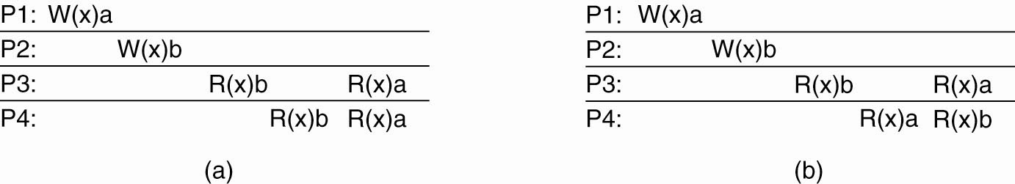
Sequential Consistency
A sequentially consistent data
store
A data store that is not sequentially consistent

Slide 63
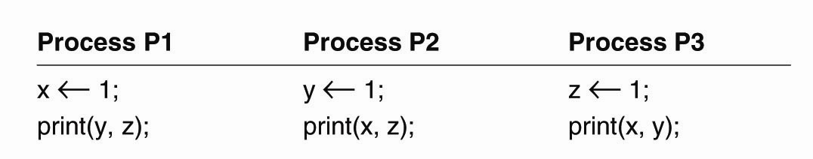
Sequential Consistency
Figure 7-6. Three concurrently-executing processes.
Which sequences are sequentially consistent?

Slide 64
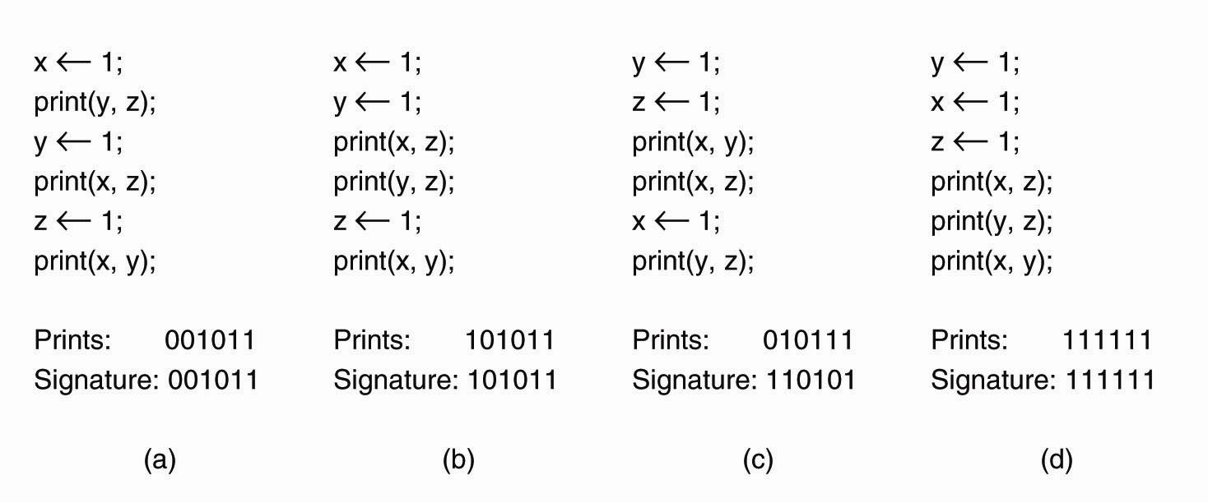
Sequential Consistency
Figure 7-7. Four valid execution sequences for the processes of Fig. 7-6. The vertical axis is time.
Here are a few legal orderings
“Prints” – temporal order of output
“Signature” – output in the order P1, P2, P3
Illegal signatures: 000000, 001001

Slide 65
Causal Consistency
Weakens sequential consistency
Separates operations into those that may be causally related and those that aren’t.
Formal explanation of causal consistency is in Ch. 6; we will get to it soon
Informally:
  P₁W(x); P₂R(x), P₂W(y): causally related
  P₁W(x); P₂W(y): not causally related (said to be concurrent)

